Slide 1
knn
Dr. Rashmi mahajan

Slide 2
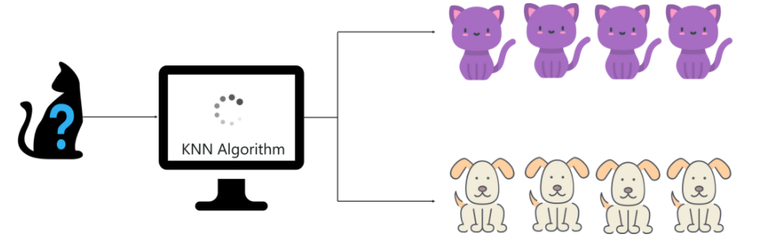
knn-Classification

Slide 3
knn
KNN is a Supervised Learning algorithm that uses labeled input data set to predict the output of the data points.
It is one of the most simple Machine learning algorithms and it can be easily implemented for a varied set of problems.
It is mainly based on feature similarity. KNN checks how similar a data point is to its neighbor and classifies the data point into the class it is most similar to.

Slide 4
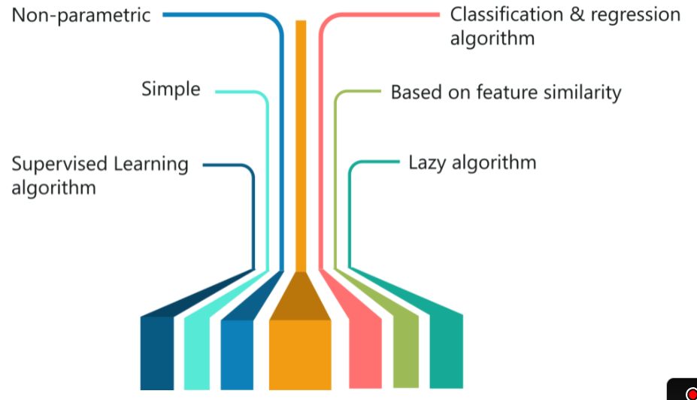

Slide 5
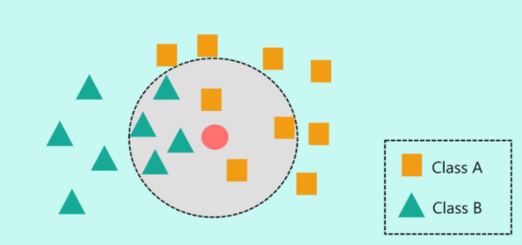
knn

Slide 6
knn
It was first described in the early 1950s.
The method is labor intensive when given large training sets.
Gained popularity, when increased computing power became available.
Used widely in area of pattern recognition and statistical estimation

Slide 7
knn
How to determine a good value for k?
Starting with k = 1, we use a test the error rate of the classifier. set to estimate
The k value that gives the minimum error rate may be selected

Slide 8
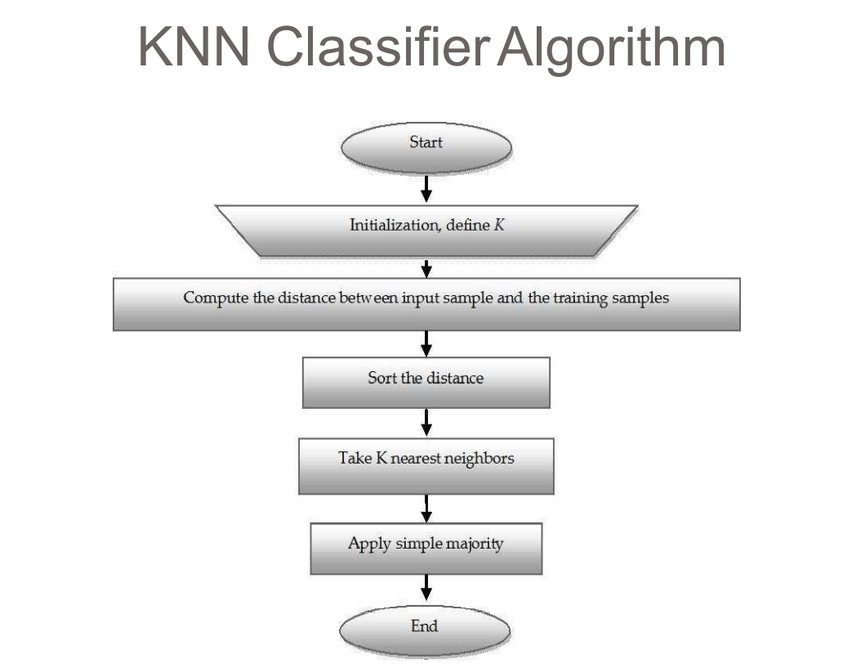

Slide 9
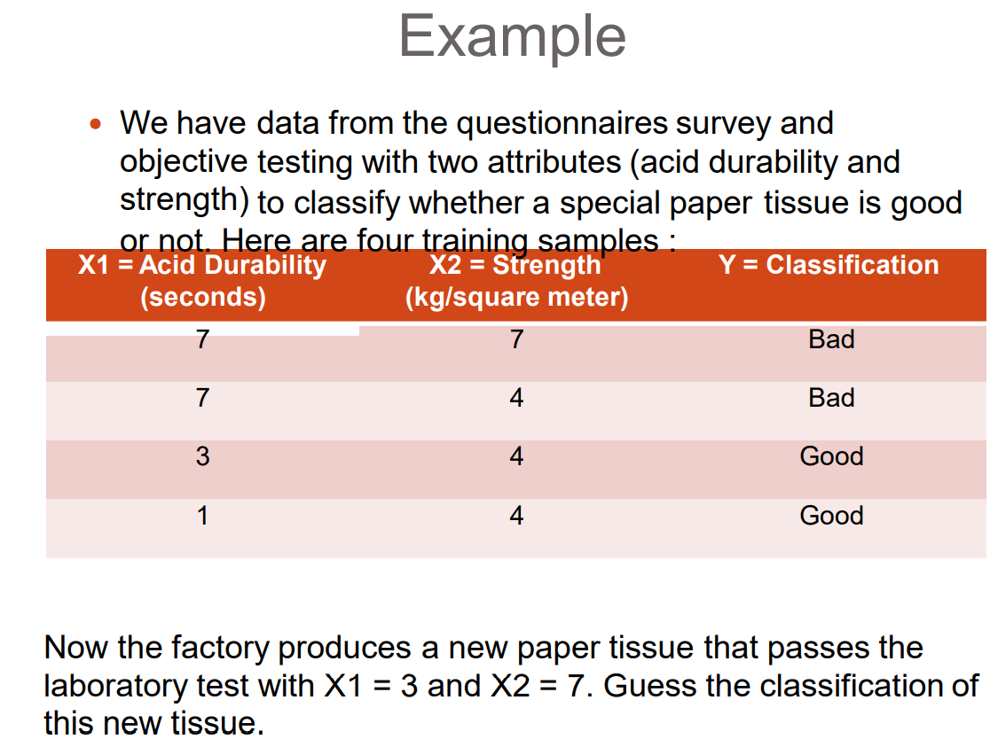

Slide 10
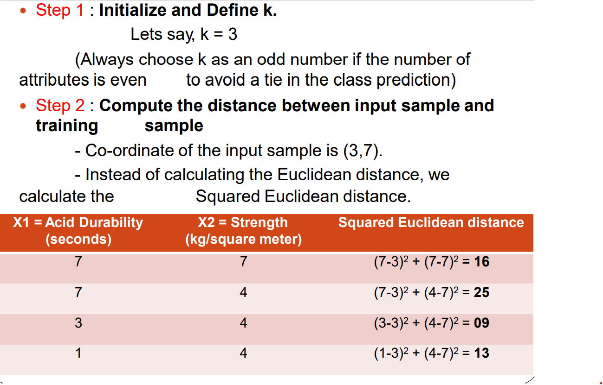

Slide 11
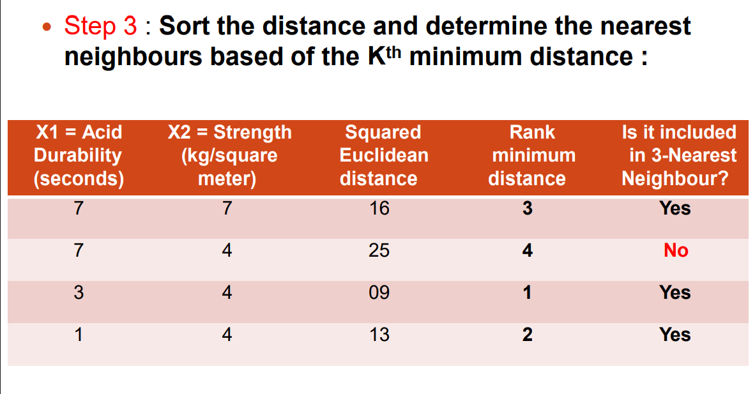

Slide 12
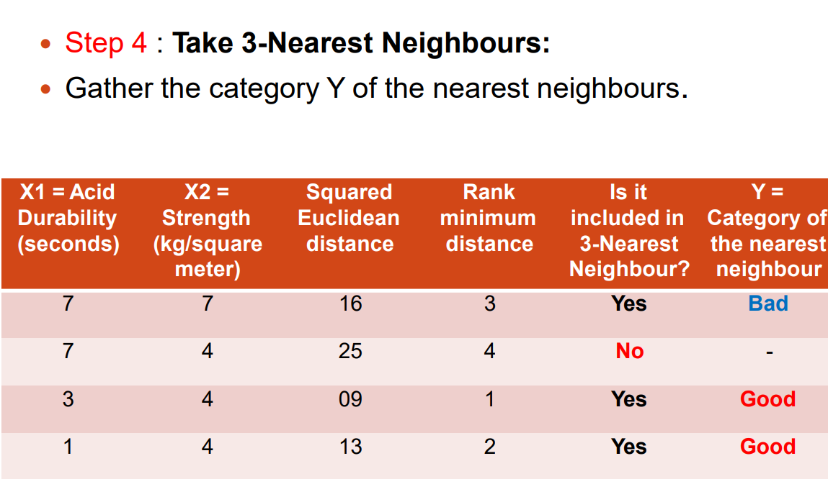

Slide 13
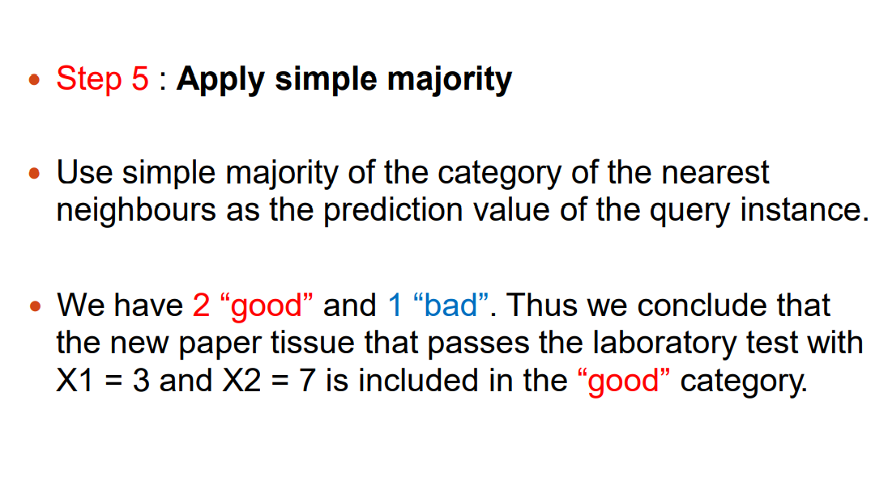

Slide 14
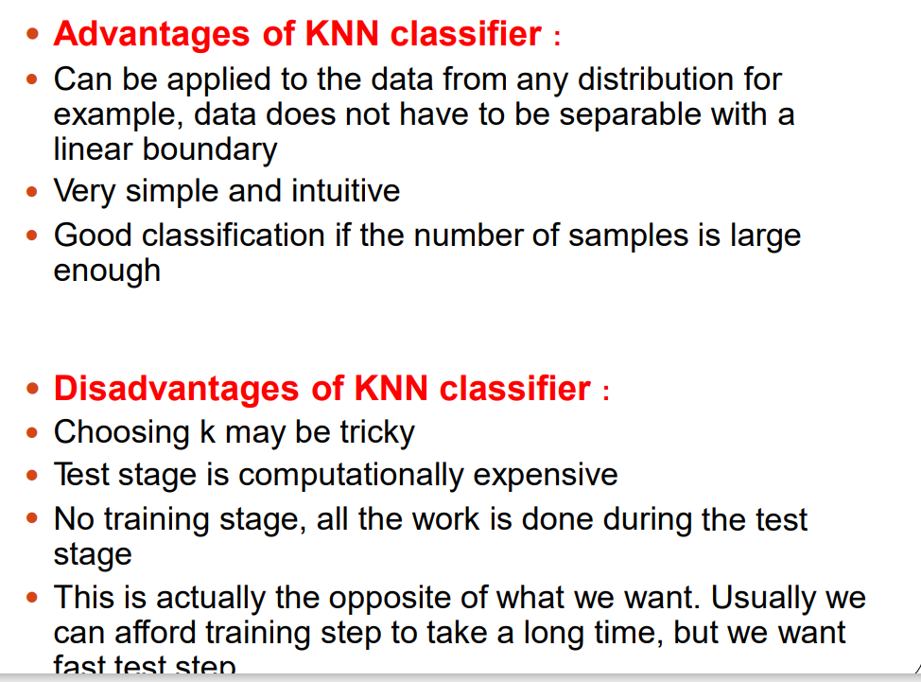

Slide 15
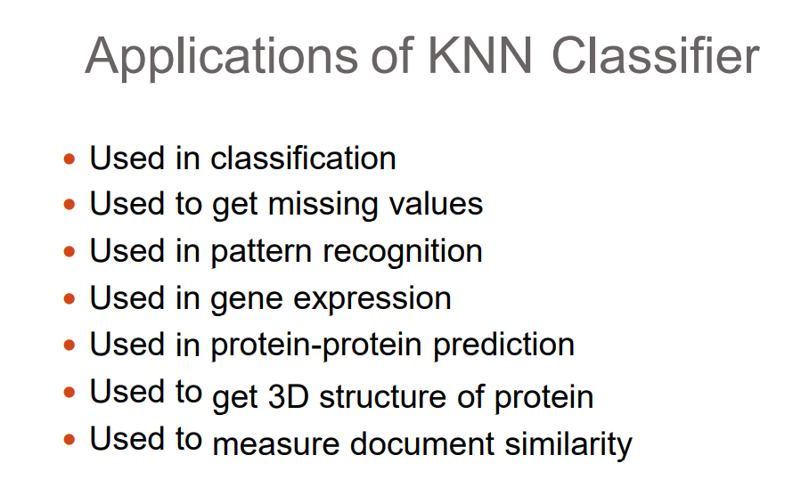
knn

